Slide 1
9- Running Python Code

Slide 2
Context
Ex.1 3
Install “Code Runner” extension 4

Slide 3
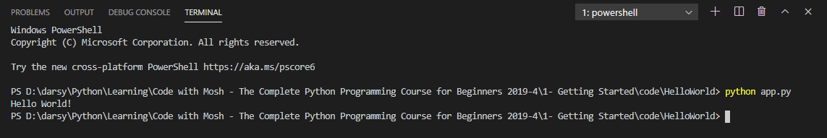
Ex.1

Slide 4
go to the extensions panel,
here search for code runner.
There are multiple code runners out there, the one that I'm talking about is this one, with the yellow icon. So go ahead and install this, and then reload vs code,

Slide 5
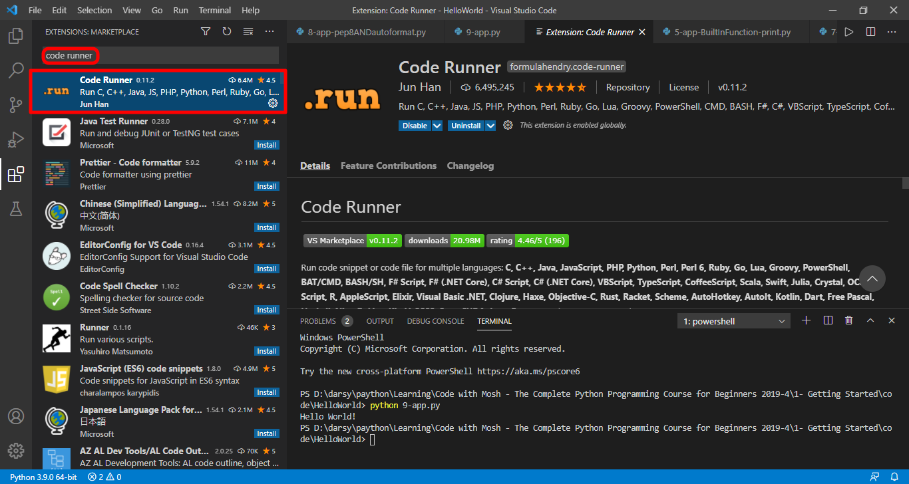

Slide 6
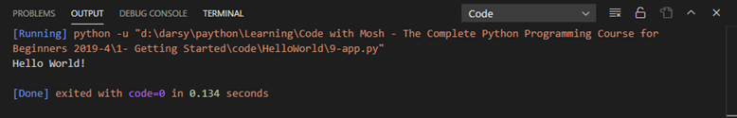
Now instead of
opening up the terminal and
manually typing python app.py
all we have to do is to press
ctrl + alt + n
Note: if you make any changes you will have to save the changes before using the shortcut, otherwise you're going to see the old result.

